Slide 1
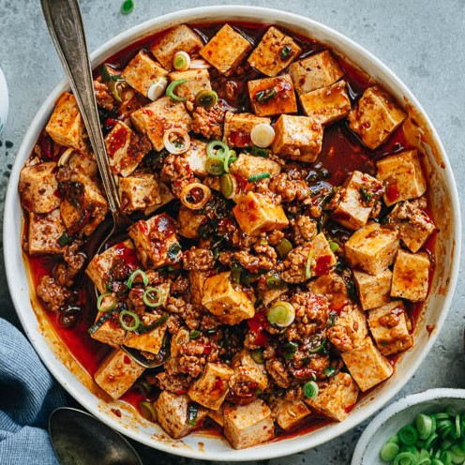

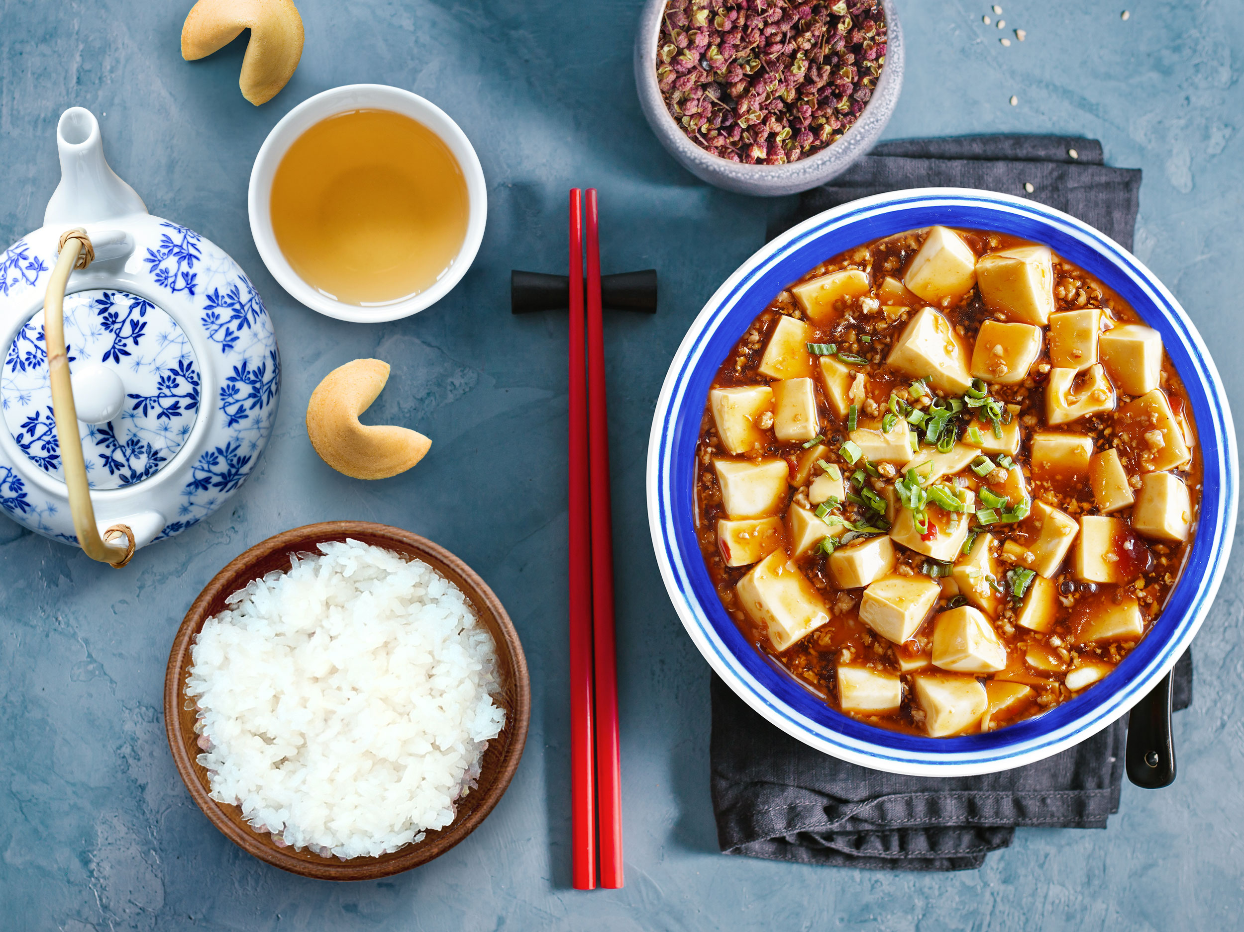

Mapo Tofu
yyuan459

Slide 2
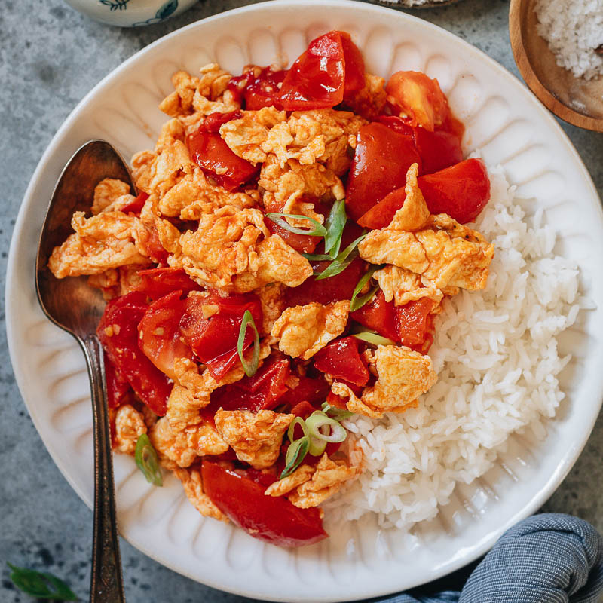
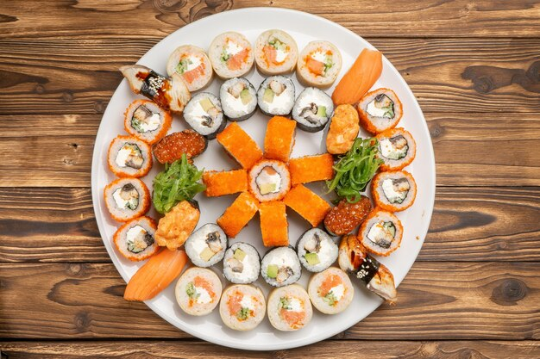
yyuan459
Home

Slide 3
yyuan459
References

Slide 4
Tomato
yyuan459
Egg
Stir
Fry

Slide 5
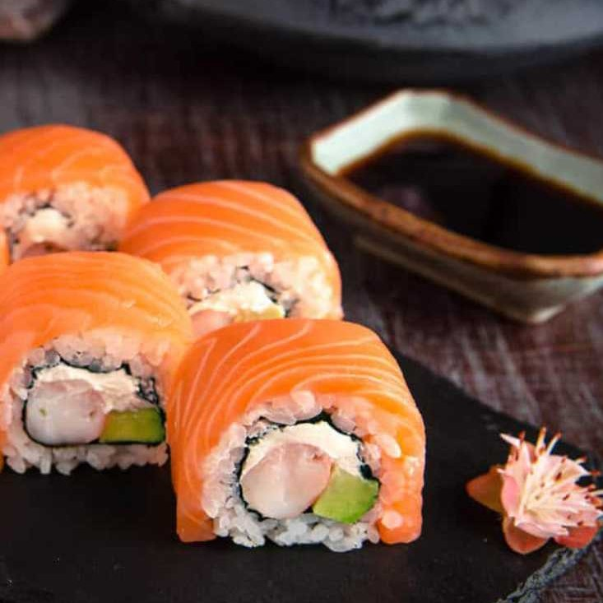
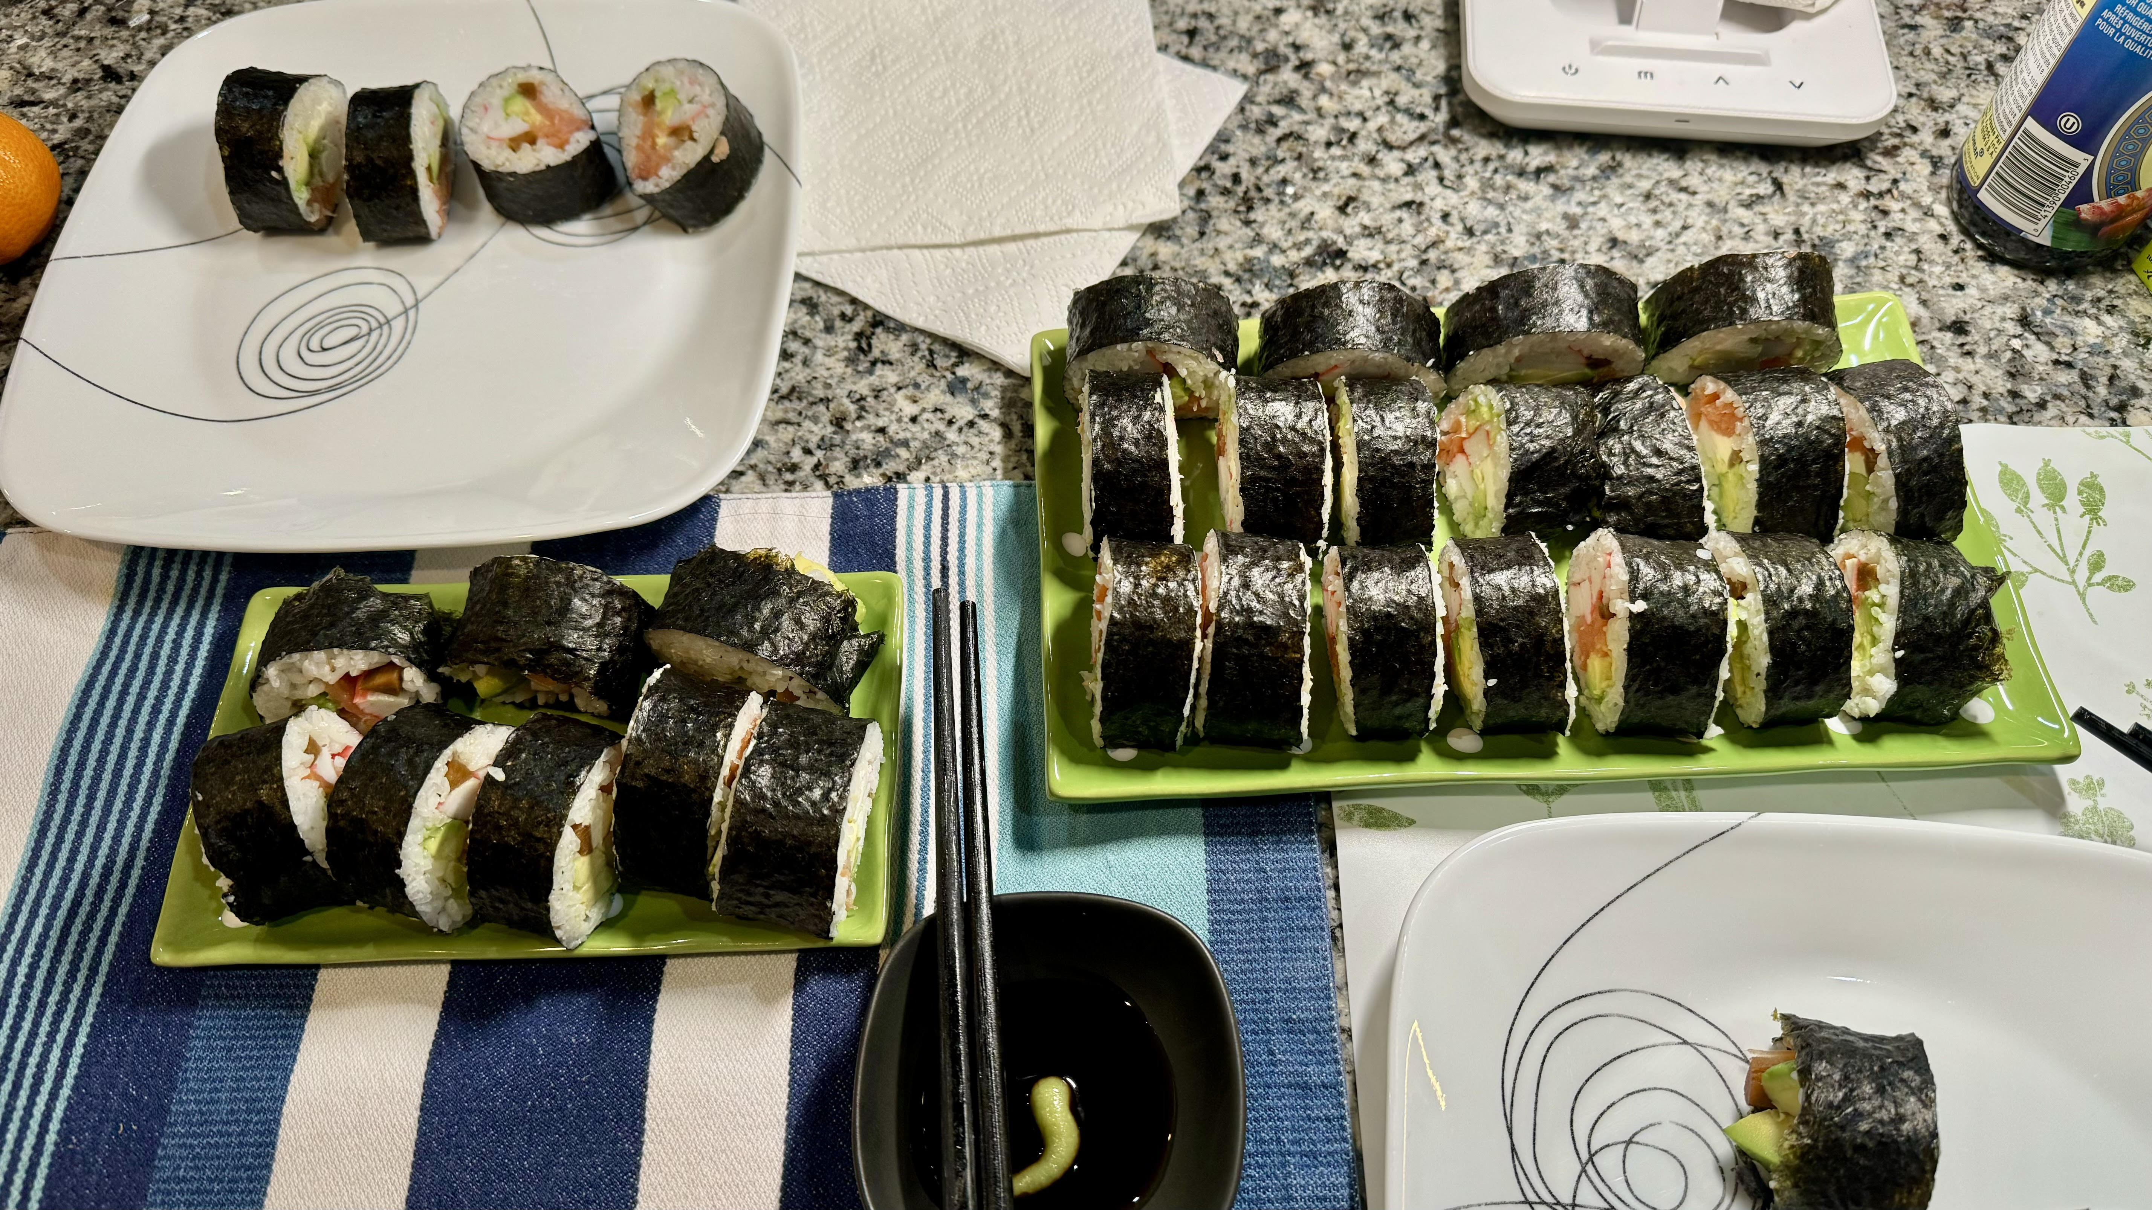
yyuan459
Sushi

